Slide 1
It’s Time for Nature
World Environment Day 2020

Slide 2
Can you design a poster, cake, piece of artwork/model, fact file or even a story that represents the theme “time for nature”?
You need to keep the environment and nature in mind so for instance you could create a piece of artwork/model from natural/ recycled material. It could be a beehive cake or a fact file about local habitats or a fictional story about life has an endanger species. I will leave that up to you.
Inspiration on the following 3 slides

Slide 3
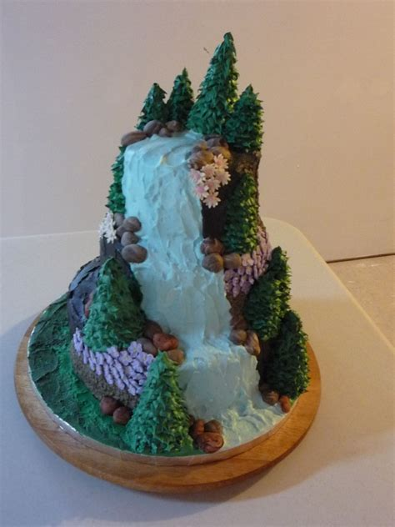
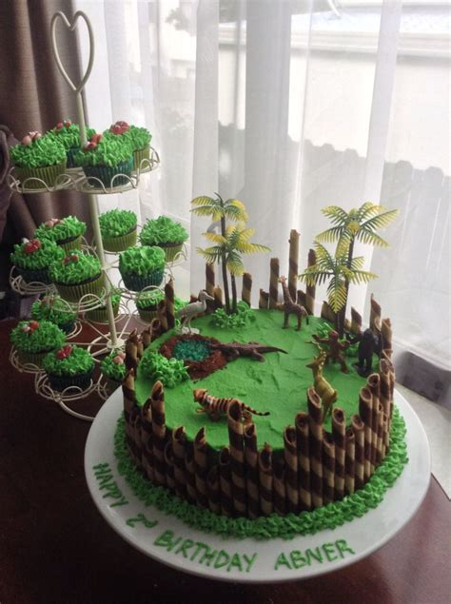
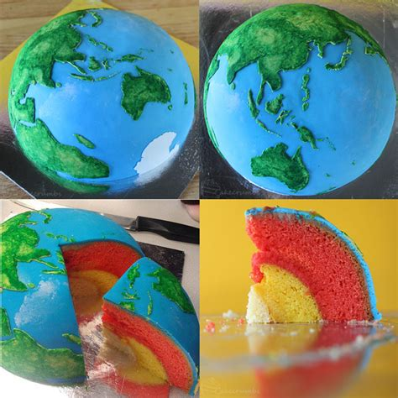
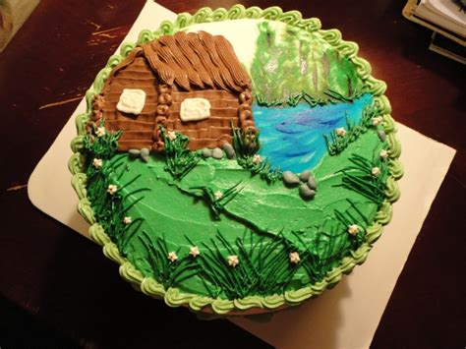
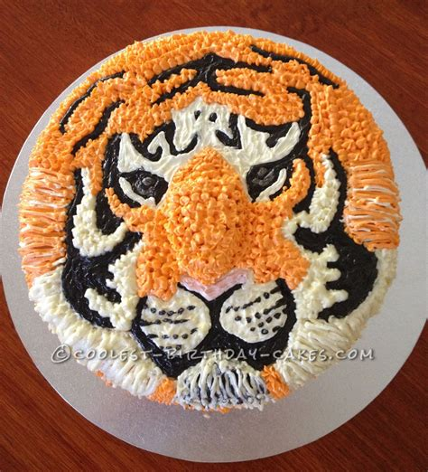
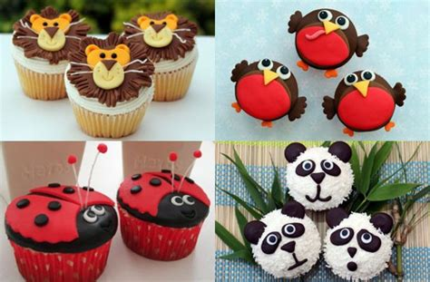
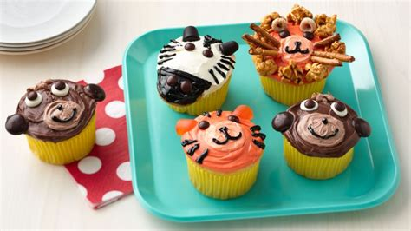
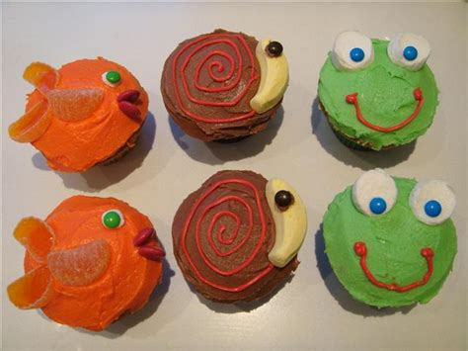

Slide 4
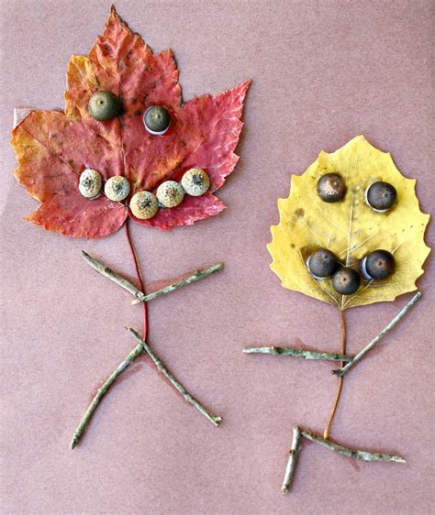
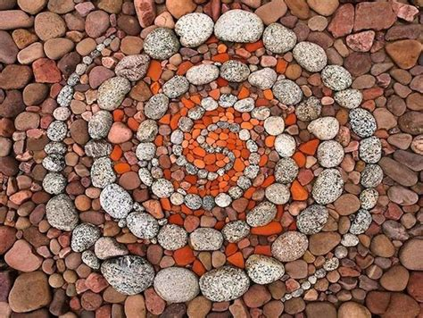
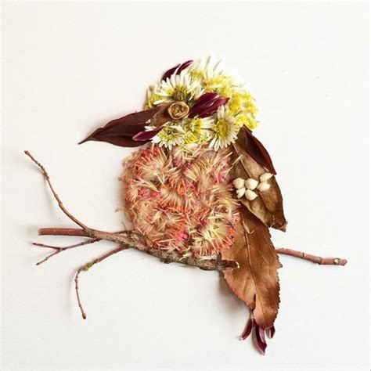
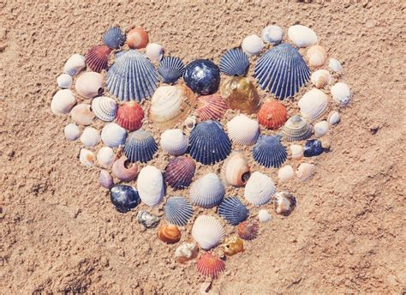
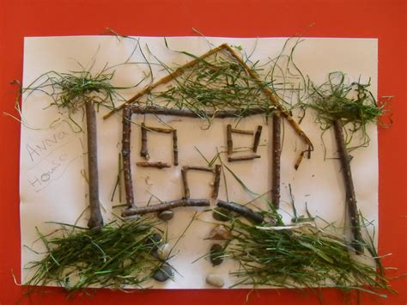

Slide 5
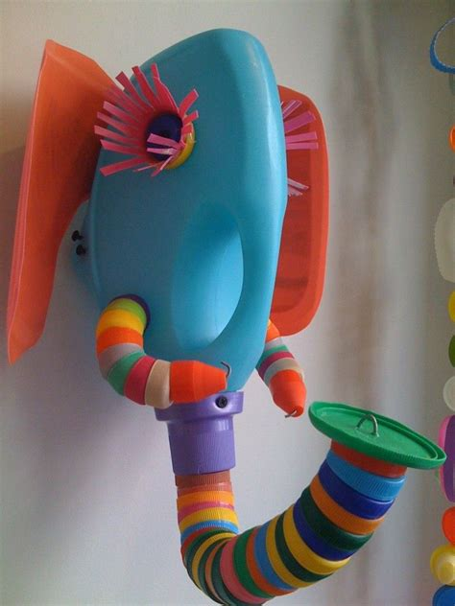
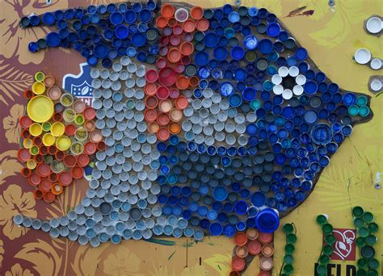
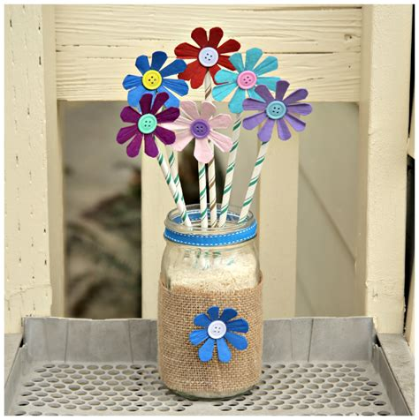

Slide 7
We have included some links below for inspiration.
https://www.un.org/en/observances/environment-day
https://www.wwf.org.uk
Have fun ☺

