Slide 1
Drama is all about developing your confidence, creativity, team work and thinking skills, drama isn’t all about being an actor; we also study theatre design such as the costumes, set and lighting.
You can select any challenge from the list or even challenge yourself and complete them all!!
The important thing is that you have a go and have fun doing it.

Slide 2
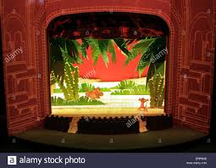
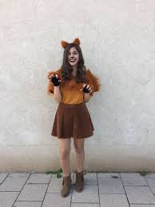
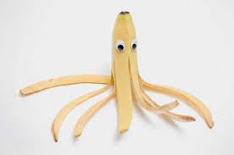
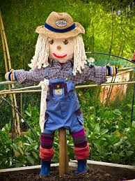
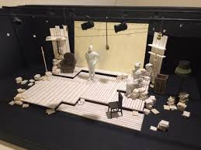
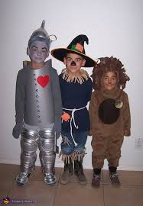
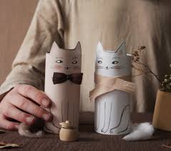

CHARACTER WORK
SET DESIGNER
COSTUME DESIGNER
Create your own character using household items. You then need to explain who this character is, their personality, their status and relationships they may have. Can you then develop this work and write a short story about this character? | Build a card box model for a scene from your favourite play or story including furniture and backdrops. | Recreate your favourite character from a play or story – design the costume, hair and make-up for the character. You can do this on paper as a sketch or in real life using yourself as the model.

Slide 3

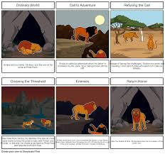



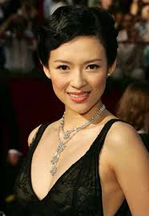
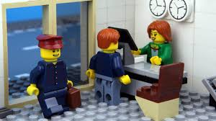
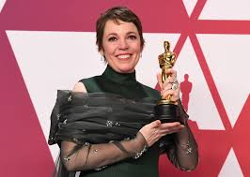
STORYBOARD
MOODBOARD
PERFORMER
Recreate a famous play or story using a storyboard – you can do this as a sketch on paper or use objects from home and photograph them (such as Barbies or Lego) | Mood board design – all about you. Create a visual moodboard that tells us all about you. | You may love performing and be really excited about drama at Eskdale. This is the challenge for you. Attached are some monologues (solo speeches) learn one and perform it.

